Slide 1
Supporting Staff Meeting
For Section Heads

Slide 3
Task effectiveness

Slide 4
From proactive to completion approach

Slide 5
Proactive approach
Self identification with IDP
Speediness with Worthiness Plan
Current and Future Planning
Encouraging
Enthusiastic
energetic
Data platform

Slide 6
Implementation
Precise assignment with job description to public
Balancing Top and Bottom –up plan with meetings
Measurement system with proto-type indicators
Sense of service with cross-mission teamwork

Slide 7
challenges
Misconceptions
Comfort zone attachment
Contribution to self benefit
Work with sense of fear

Slide 8
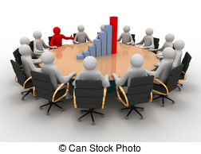
Completion approach
Implementation plan
Better task
Function with
collaborative
Participatory
networking
More inspiration
Incentive and promotion growth
Up- Mid – Down stream as one
Misconception eradication
Self reliance with academic building up
Objectives

Slide 9
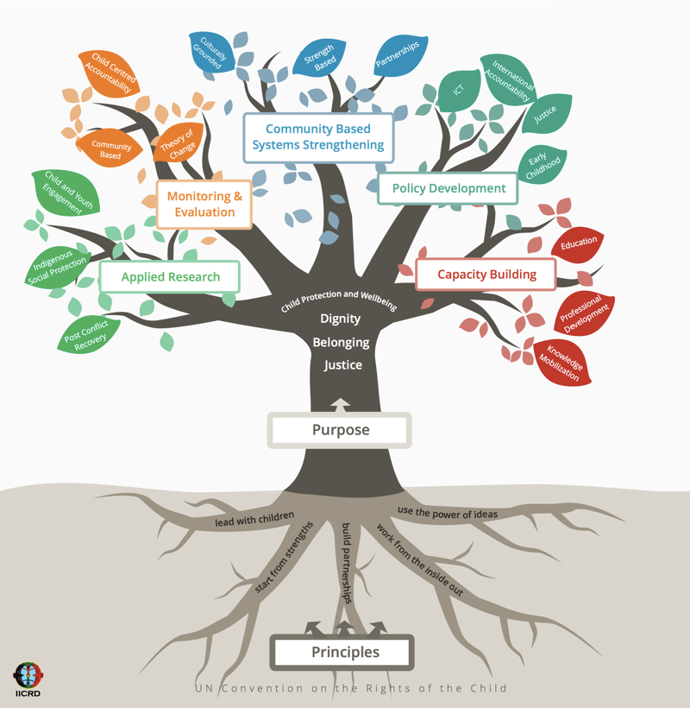
Up-stream, mid-stream, down-stream
Mid- stream
Set up assignments
Follow-up project
Innovate academic products
Up-stream
Down stream
Preparation
Inbound and Outbound PR
Analyzed and synthesized data
In hand service information
Set and follow assessment system
Presentation and Report
Self and Organization evaluation
Incentive and Reward

Slide 10
What to concern?
Misconception eradicated
Triple “I” Policy for everybody
University of Integrity for the people
Four Focuses of Innovation by Supporting staff
University policy comprehension
Related mission performance
Research-based working
Teamwork operation
Care and share with multi-disciplinary and experience
Profit sharing

Slide 11
Thank you!

